Slide 1
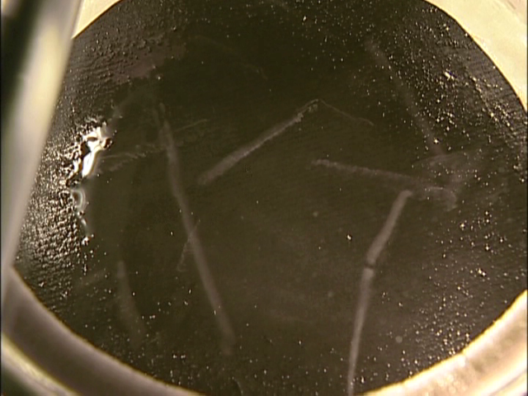
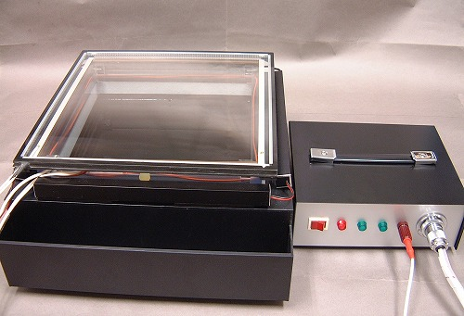
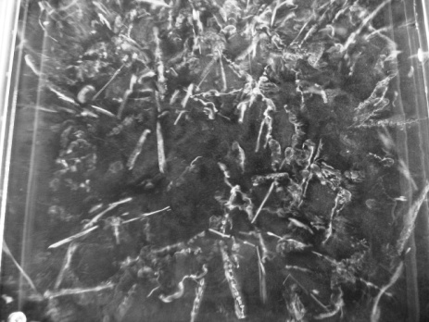
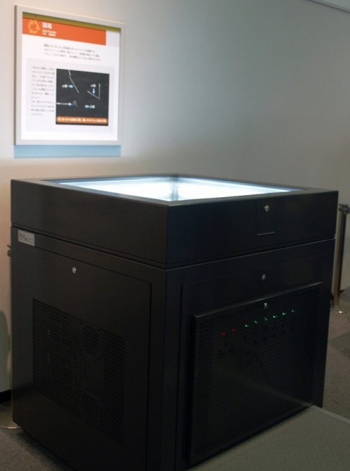
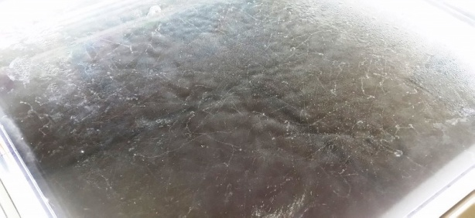
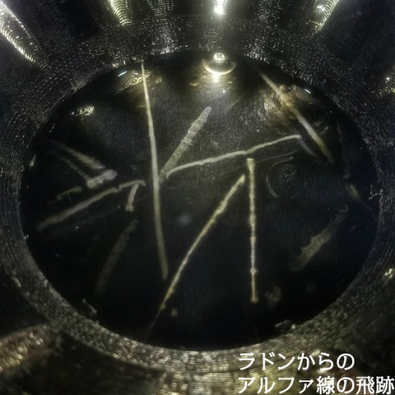
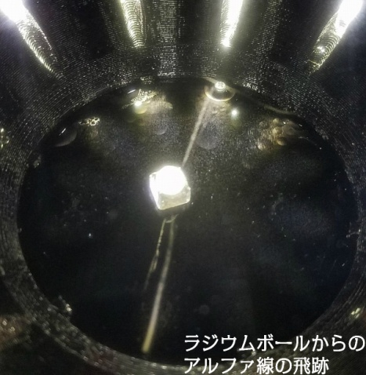
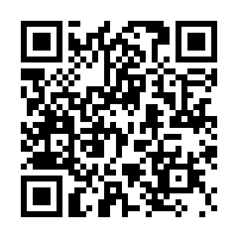
Practical School Application of
Cloud Chambers for
Various Education Subjects
¹ Takehiro Toda, ² Takeshi Iimoto
¹ RADO corporation(RADO) /Member of Japanese volunteer’s Expert Team (JVET), Toyama, Japan.
² The University of Tokyo (U Tokyo)/Coordinator of JVET, Tokyo, Japan. INDICO ID #289
Why is Cloud Chamber for School Education?
Types and characteristics of cloud chambers and their current main educational purposes
Cloud Chamber is a revolutionary device that allows us to see tracks of radiation. Cloud chambers have been mainly used in the field of radiation and nuclear science education. However, we believe that this device has great potential to be used for various educational subjects.
For example, in arithmetic, students can learn line graphs by using a cloud chamber to count the number of radiation changes over time.
In high school math, students can use the graph to calculate the half-life of a substance or study exponential functions.
Students can also learn to apply the theorem of the three squares by measuring the length of a radiation path using a cloud chamber.
In geography, the cloud chamber experiment is also useful for considering nuclear power generation as one of the solutions to the world's energy problems.
In geology, students can use cloud chambers to learn about rocks that emit radiation.
In the field of meteorology, cloud chambers can be used to learn about the process of cloud formation.
In this way, the cloud chamber can be used in a variety of subjects and grade levels.
Types of cloud chambers | Pictures | Features and educational purposes
Dry Ice cooling （small & middle） |  | Assembling cloud chamber by hands in schools Understanding the principle of the cloud chamber Radiation sources; monazite and radon gas
Dry Ice cooling（large） |  | Mainly for high school and university students Experiment of the permeability of radiation Experiments on the Compton scattering and half life Using liquid nitrogen, easy to got at schools. Mainly for observation of the tracks of natural radiations
Liquid nitrogen cooling
Compressor cooling |  | Displayed in science museums Observing many tracks through a large observation window Easy to understand the existence of the natural radiation Coolant such as dry ice, unnecessary Easy to observe long tracks of cosmic rays
Peltier element cooling |  | Coolant such as dry ice, unnecessary. Short preparation time to see tracks of radiation Radiation sources; monazite and radon gas Mainly for observation of the tracks of natural radiations
Practical School Application of Cloud Chambers for Various Education Subjects
The table below shows some examples of its possibility following the Japanese official syllabus.
Generation Level and Subject | Explanation in Japanese Syllabus | Education Contents using Cloud Chamber | Education Contents
Grade 4 (9 years old) Arithmetic | A. Number and Calculation B. Graphic C. Change and Relationship (a) Through mathematical activities related to two quantities that change with each other, teach students to acquire the following skills. (1) To represent changes using tables, formulas, and line graphs, and to read the characteristics of changes. | Using a cloud chamber, alpha particle tracks can be observed. In the case of radon gas, the number of particles would be decreased minute by minute. On the other hand, in the case of monazite rocks, the number would not be timely changed. These time variations are recorded in tables and drawn in line graphs. The difference between them can be found and read by the tables and the graphs. | Introduction of the experiments including explanation on cloud chamber. (20min) Observation of radiation tracks in cloud chamber. (5min) Recording time variation of number of alpha particles from radon gas and monazite rocks (cpm). (10min) Drawing graphs of the time variation above and comparing changes over time. (10min) Total 45min
High school ( 15～17 years old) Geography | B. International understanding and cooperation (2) Global issues and international cooperation (a) Based on the global environmental problems, resource/energy problems, population/food problems, housing/urban problems, etc. seen in various parts of the world, the solution to global issues is the efforts of each country aiming to realize a sustainable society. | Using a cloud chamber, students can observe how radiation is emitted by nuclear fission. Students can deepen their understanding of the basic mechanisms and safety of nuclear power generation. In addition, students can develop scientific problem-solving skills through experiments. These capabilities help | Explanation of carbon dioxide emissions from nuclear power generation (5min) Comparison of the lifespan of uranium and fossil fuels(10min) Explanation of the relationship between nuclear power generation and radiation (10min) Explanation and implementation of cloud chamber experiments(10min) Understanding the nature and types of radiation(5min) Total 50min
Educational Application of Cloud Chambers Targeting Each Generation Level
To assist educators in Member States, sample lesson plans for radiation education using different types of cloud chambers have been prepared.
These sample plans, document "Educational Application of Cloud Chambers Targeting Each Generation Level", show cloud chamber applications for different generations, from elementary school students to high school students.
These plans include not only science, but also various subjects such as geography, history, political economy, and mathematics. There are 28 such plans in total.
The document is uploaded and available for download on the following website: https://jvet.jp/fruits
International Conference on Nuclear Knowledge Management and Human Resources Development:
Challenges and Opportunities

