Slide 1
DEVELOPMENT AND APPLICATION OF TOOLS AND MODULES WITH WOW FACTOR FOR NST SCHOOL EDUCATION
EVT2300041/CN-324
Logistical Information Relating to the International Conference on Nuclear Knowledge Management and Human Resources Development: Challenges and Opportunities - 1-5 July 2024
https://jvet.jp/
Takeshi IIMOTO^{1,5}, Hiromi KOIKE^{1,5}, Rieko TAKAKI^{2,5},
Takehiro TODA^{3,5}, Taichi KATO^{4,5}, and Tomohisa KAKEFU^{4,5}
¹The University of Tokyo, ²Energy Communication Planning,
³Rado, LTD, ⁴Japan Science Foundation, ⁵JVET (Japanese volunteer’s Expert Team)
Logistical Information Relating to the International Conference on Nuclear Knowledge Management and Human Resources Development:
Challenges and Opportunities - 1-5 July 2024

Slide 2
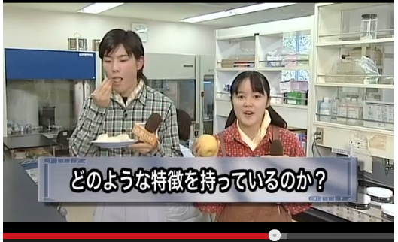
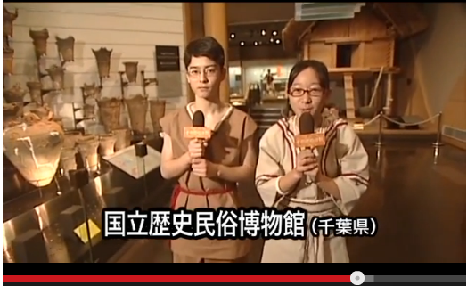
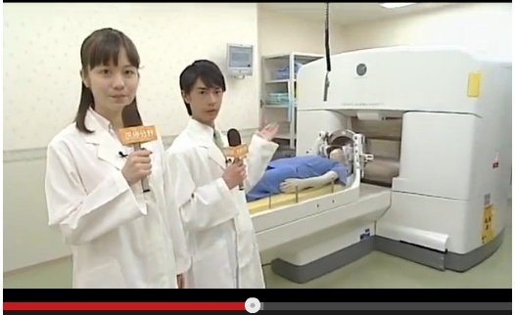
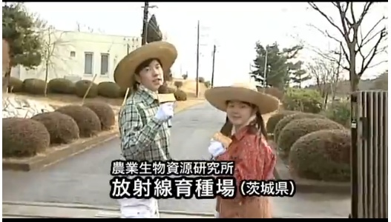
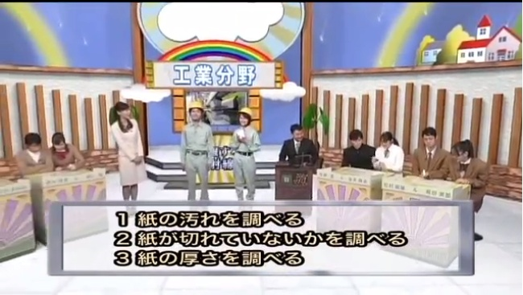
The WOW factor
[Japanese] http://www.radi-edu.jp/
[English] http://www.radi-edu.jp/en/
JVET (Japanese Volunteer‘s Expert Team) has been trying to insert “WOW factors” into the tools/modules in STEAM-NST education track and has been sharing our experiences with member countries under the IAEA-Technical Cooperation Program, using an information platform called RADI. We continue and develop our activity under receiving feedback from and collaboration with member countries in the Asia-Pacific region.
Fun!!
Motivate!
Enjoy!!!
Logistical Information Relating to the International Conference on Nuclear Knowledge Management and Human Resources Development:
Challenges and Opportunities - 1-5 July 2024

Slide 3
https://jvet.jp/
JVET (Japanese Volunteer’s Expert Team); originally a team of volunteers joining Technical Cooperation Programmes of IAEA etc., from 2012.
The core activity of JVET; training of secondary school students and teachers in the Asia-Pacific region.
Now expanding the scope to university and postgraduate students, as well as young professionals.
Logistical Information Relating to the International Conference on Nuclear Knowledge Management and Human Resources Development:
Challenges and Opportunities - 1-5 July 2024

Slide 4
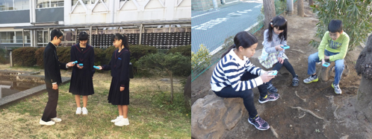
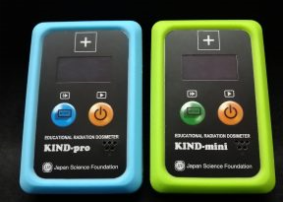
Cloud chamber of Peltier cooling type with a wide observation window
NST-EDUCATIONAL TOOLS AND MODULES DEVELOPED
Next-generation environmental radiation survey meter;
KIND-pro/mini series
great difficulties in obtaining and handling dry ice
Peltier Cloud Chamber with Φ 75 mm observation window
The features that dry ice is not required as well as wide observation window have greatly improved the ease of experimentation not only at school sites in Asia-Pacific countries but in any public places.
received many requests for size miniaturization and cost reduction of an educational survey-meter
ICT (Information and Communication Technology) into classroom educations
KIND-mini (plastic scintillator) and KIND-pro (CsI (Tl) scintillator) as next-generation environmental radiation survey meters, developed
These tools have become very popular as a driving force of WOW factor in NST school education.
Size of each is 95x60x17mm and weight is 100g. They were designed to minimize their function as a radiation measuring instrument in order to achieve the highest priority to the ease of handling for younger students.
https://kiribako-rado.co.jp/
Logistical Information Relating to the International Conference on Nuclear Knowledge Management and Human Resources Development:
Challenges and Opportunities - 1-5 July 2024

Slide 5
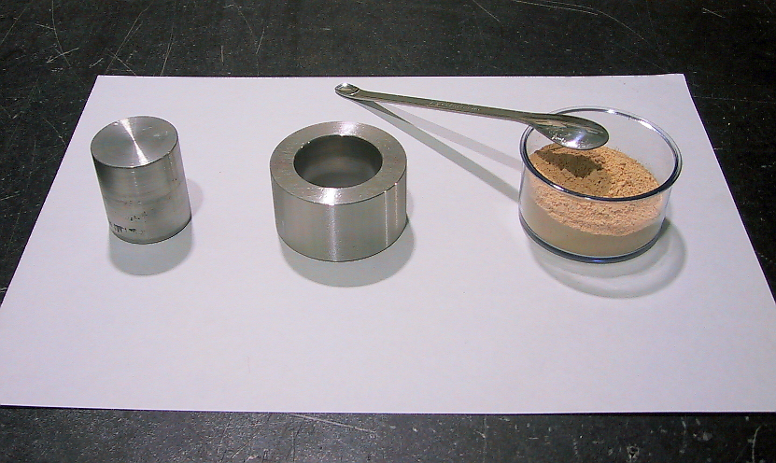
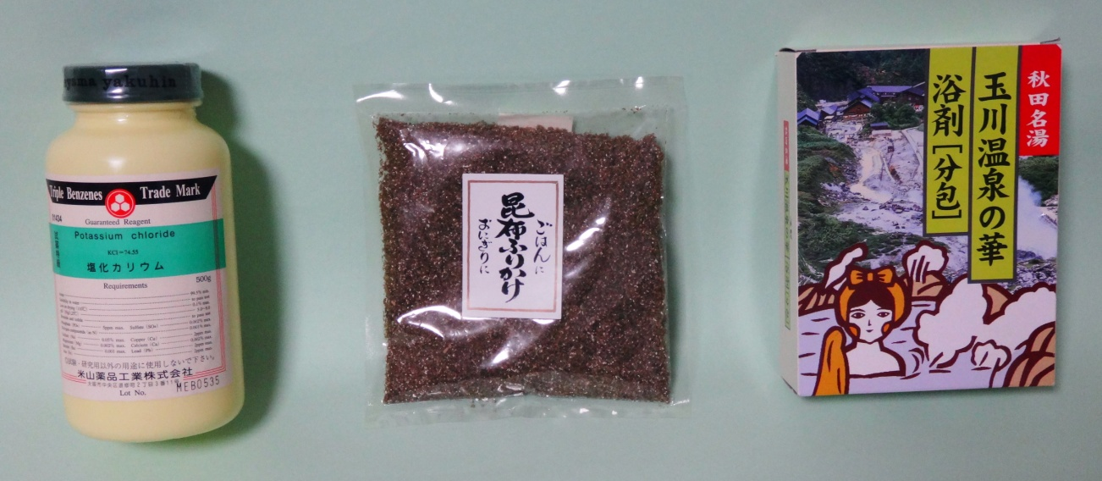
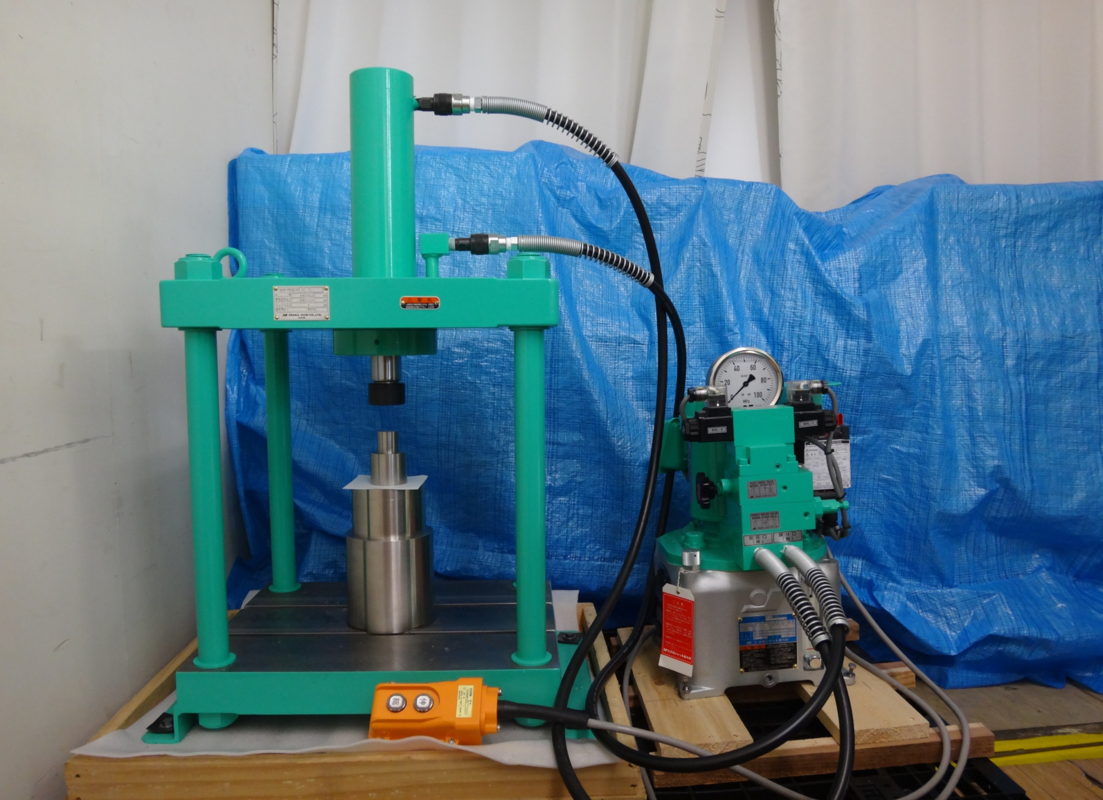
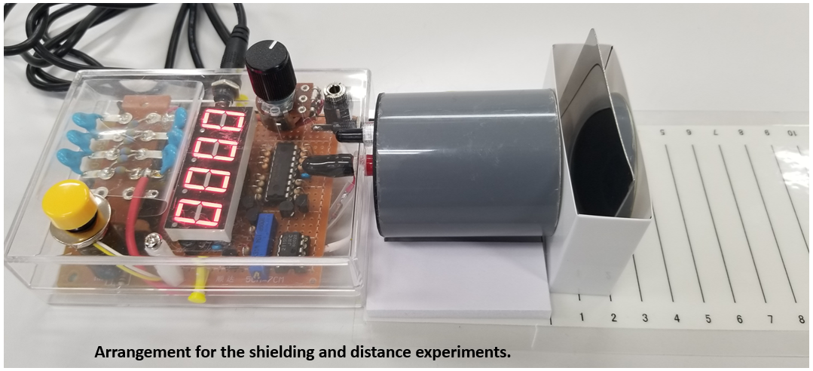
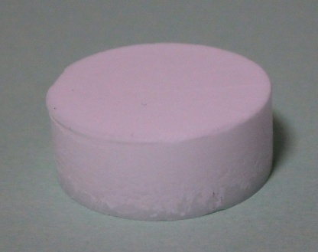
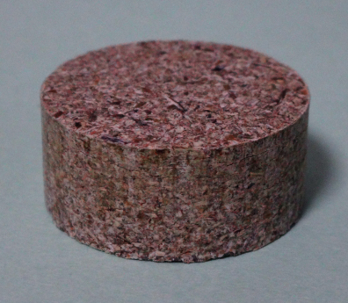
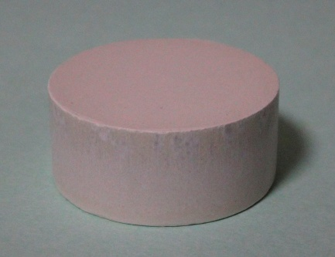
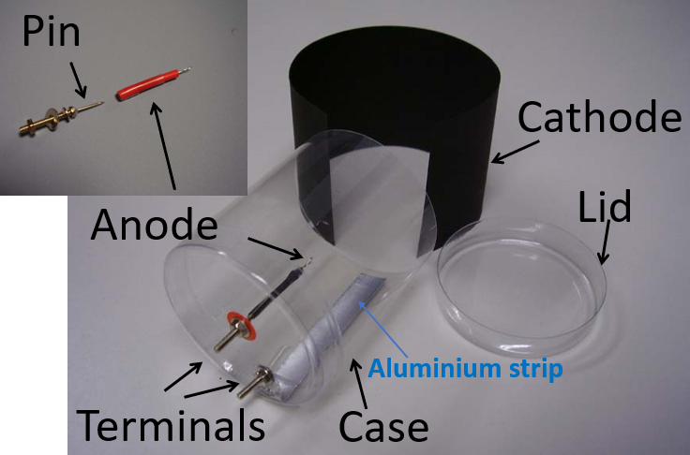
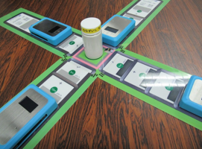
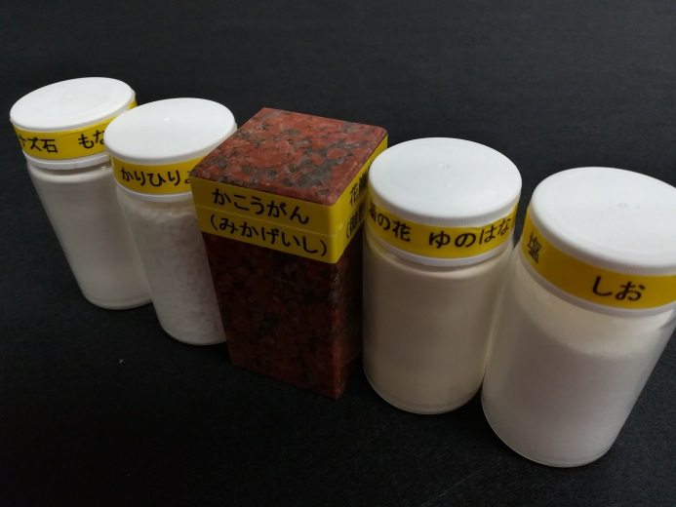
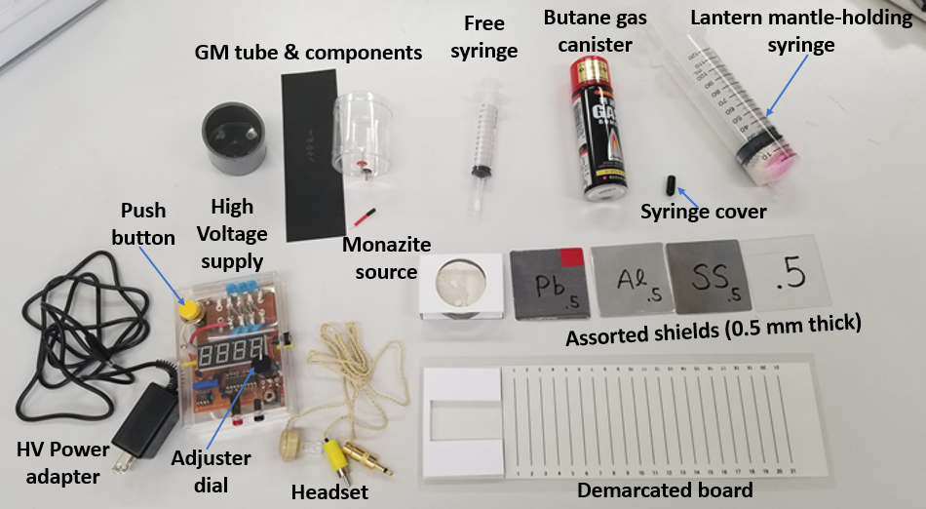
Assembling kit for radiation counting
NST-EDUCATIONAL TOOLS AND MODULES DEVELOPED
Radiation sources
made of natural substances
a radioactive sample kit for school uses
consisting of a) monazite rock powder, b) mineral encrustations left by hot springs containing natural radioactive radium and thorium, c) granite rock containing natural radioactive potassium, d) potassium-enriched fertilizer, and e) edible salt with enriched potassium
strong requests from international education sector to experts; "I want to get a radiation source for NST experiments that anyone can use anywhere.“
applying a compression molding machine, natural powder with potassium for school science experiments, sprinkling edible kelp, powder of radioactive hot springs etc., made into coin-shaping radiation sources (around 5-20 Bq/g (⁴⁰ K)).
In order to promote the usage of educational survey-meters in schools as well as to investigate new way to use the kits in Japan, “contests” among students and teachers as a Japanese nation-wide project has been held every year.
hand-made air GM counter for radiation, helping students to understand the structure of the GM tube, and allowing them to experiment with half-life, shielding, etc.
These sources enable radiation shielding experiments and radiation distance attenuation experiments using a wide-window type GM counter. JVET has continuously been developing radiation sources using new NORMs such as coffee beans and sodium-reduced salt.
Logistical Information Relating to the International Conference on Nuclear Knowledge Management and Human Resources Development:
Challenges and Opportunities - 1-5 July 2024

Slide 6
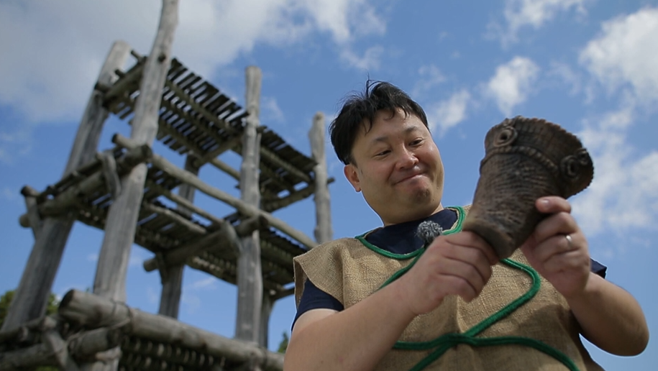
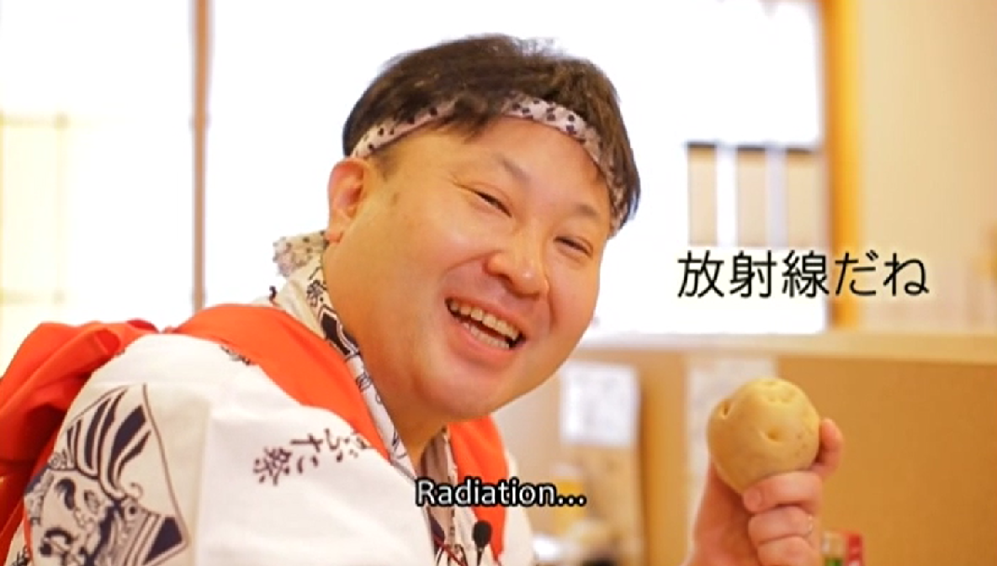
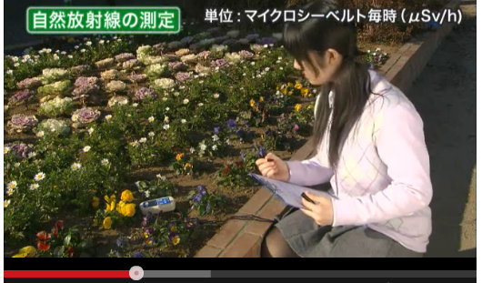
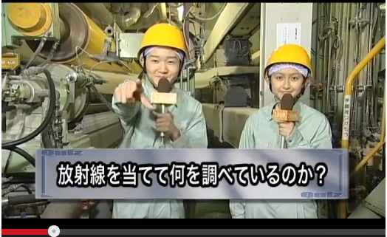
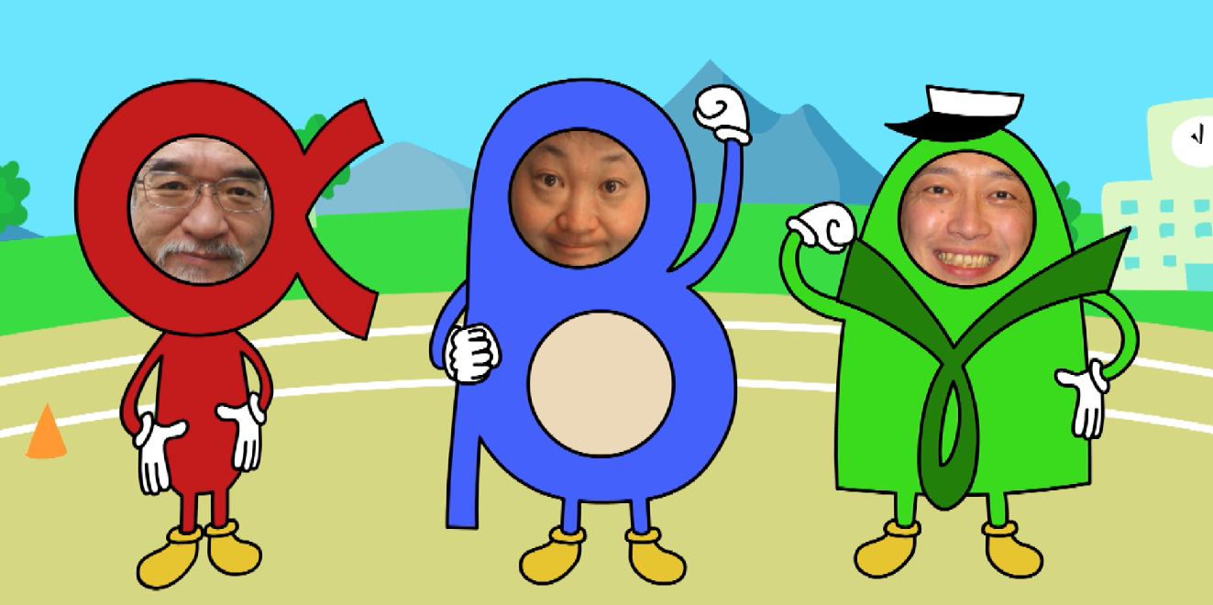
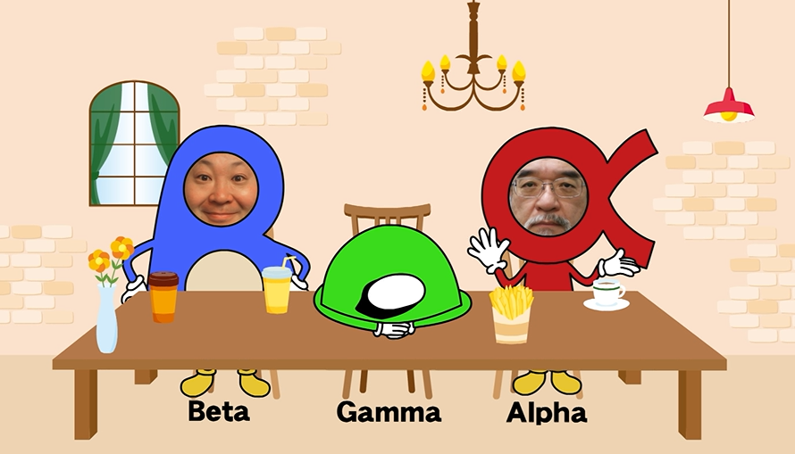
NST-EDUCATIONAL TOOLS AND MODULES DEVELOPED
NST educational movies
with WOW factor
In order not only to expand the school NST education but also to maintain its status, some mechanism for students and teachers to have a strong and continuous interests in the NST educational content plays its important role.
WOW Factor may be directly related to the mechanism.
The timing just before and just after the first class of the introduction of NST education would be an important gateway to promote their interest.
JVET prepared short movies with a strong impression of 3 minutes to improve their motivation for active learning.
In addition, several commentary movies of about 20-40 minutes were designed and created for the purpose of being used by teachers in their NST classes of 1-2 hours.
JVET also prepared a funny video collection of 1 min x 10 stories with a lot of entertainment elements to review the classes and their continuous learning motivation for post lessons.
Movie tools like these are one of the strongest professional supports for busy teachers.
Logistical Information Relating to the International Conference on Nuclear Knowledge Management and Human Resources Development:
Challenges and Opportunities - 1-5 July 2024
6

Slide 7
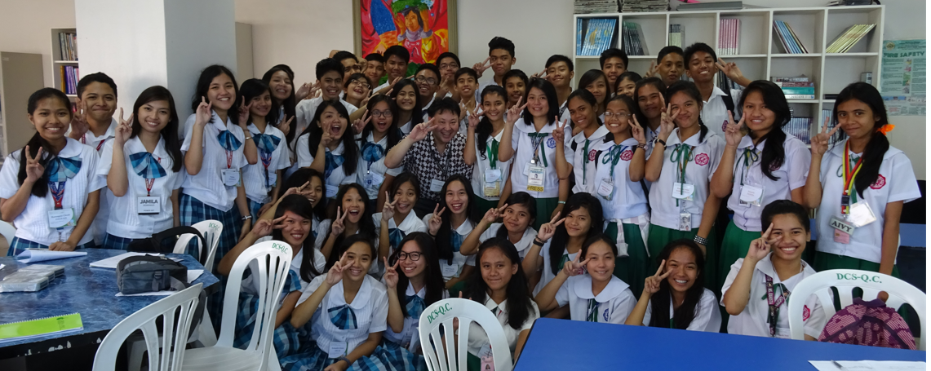
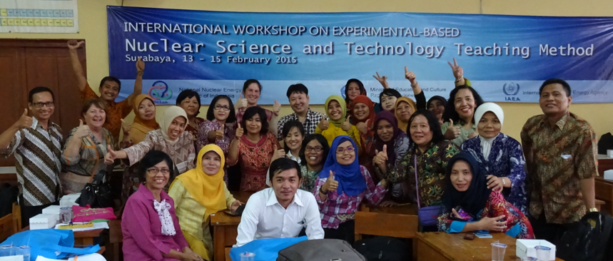
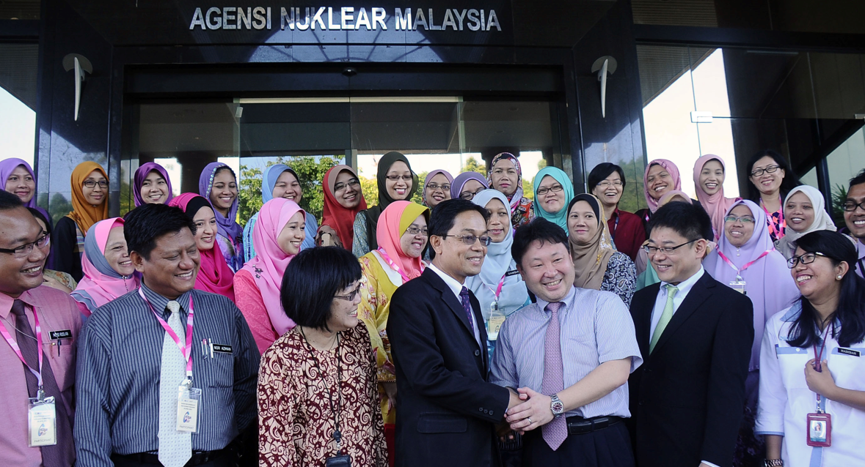
SUGGESTION TO STAKEHOLDERS
JVET photos in The Philippines, Indonesia and Malaysia
Message to member countries to start NST school education
A lot of skilled experts to support schools and teachers are needed in the world. “Skilled” means not only on the level of knowledge on NST or experience of NST application, but also on the teaching experience and communication ability. JVET recommends member countries to select adequate and attractive candidates and start to train them to be “star teachers” as soon as possible. JVET recommends them to prepare education materials (handouts, PPT materials, work sheets, experimental tools and modules, etc.) and their instruction documents for teachers, and distribute them, which can be directly used by teachers in their classes. Showing and opening real radiation/nuclear sites to teachers and/or students is one of the best experiences for them to be interested in the NST field. JVET recommends them to establish the systematic framework to accept them into each institution or university relating to NST application. It is very difficult to teach high-level science contents to teachers and students. Nuclear risk and radiation risk are typical examples of the most difficult items in school education. Not only NST experts, but risk communicators or social scientists should also join the discussion to prepare the education materials. JVET recommends that national framework or system to support teachers should be developed through local/domestic resources to meet the stated objectives of each country. This may include developing information web platform with instruction movies and teaching materials in local languages and cultures, etc. RADI, ANENT, etc. would be good examples.
Logistical Information Relating to the International Conference on Nuclear Knowledge Management and Human Resources Development:
Challenges and Opportunities - 1-5 July 2024

Slide 8
Message to IAEA
SUGGESTION TO STAKEHOLDERS
JVET recommends IAEA to make a special guideline for member countries on manufacturing and the use of radiation sources for education purpose, for example in cloud chamber experiments, in addition to IAEA Safety Standards Series No. SSG-87 entitled “Radiation Safety in the Use of Radiation Sources in Research and Education” as a Specific Safety Guide. They would like to use radiation sources including thorium, potassium etc. in their school classes. However, it is difficult for stakeholders in schools on radiation education to understand and to apply the description of IAEA-BSS (GSR-Part 3) into their activities. Radiation protection experts relating to RASSC or WASSC as well as the education experts should be involved on this matter.
JVET also recommends IAEA to continue to systematically support the pilot countries and following countries in the IAEA TCP strongly. Establishment of good education system and human development of skilled teachers will take a long time and need international good advisors. JVET recommends IAEA to continue and develop the related projects/programmes more and more to share our activity and message to other countries in the world in addition to the existing countries. JVET believes member countries are waiting the chances, and they are ready to join this activity. Advanced modules or programs as well as standard ones should be developed in the next season. JVET recommends IAEA to support continuing to exchange the newest information and knowledge among expert countries. These additional activities among expert countries will improve the motivation of the early pilot countries.
In addition, JVET would like to know the concrete effectiveness of our HRD activities under the programme. Especially the data on the scholarship direction to the university or graduate school of the secondary school students who received our education under the IAEA TCPs is really needed and informative to evaluate our mission as well as the data of the number of developed teachers. JVET recommends IAEA to establish a framework to systematically gather the information.
The first-stage pilot countries of the IAEA TCP, such as the Philippines, Indonesia, Malaysia, Sri Lanka and Oman etc., should be strong leaders for the following countries in the RAS 0065/0079/0091 TCPs. IAEA should push and motivate them up continuously. Expert countries including Japan are also waiting for a lot of feedbacks from them to promote and improve their activities more and more. For example, JVET believes INSTA (International Nuclear Science and Technology Academy) and INSO (International Nuclear Science Olympiad), etc. could become parts of the effective and strong accelerators or platforms for them above.
Logistical Information Relating to the International Conference on Nuclear Knowledge Management and Human Resources Development:
Challenges and Opportunities - 1-5 July 2024

Slide 9
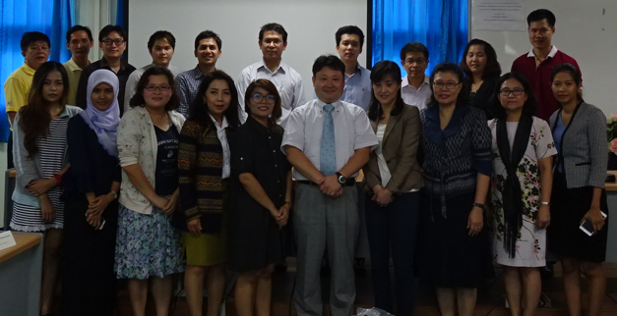
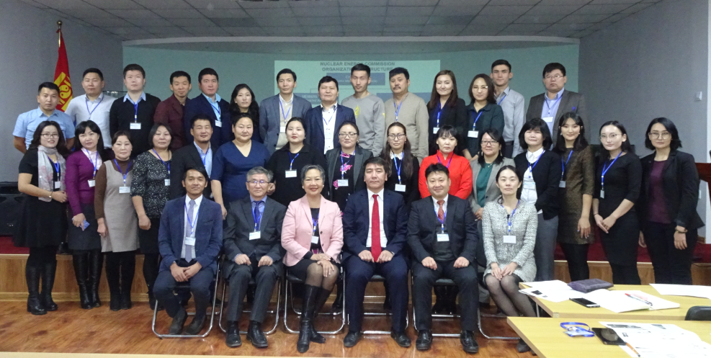
Conclusion
JVET photos in Oman, Thailand and Mongolia
Line-up of main examples of NST educational tools and modules developed by JVET so far for school education was reviewed, such as (1) a cloud chamber of Peltier cooling type with a wide observation window, (2) a next-generation environmental radiation survey meter, (3) an assembling kit for radiation counting, (4) radiation sources made of natural substances, and (5) NST educational movies with WOW factor to kick-off/closing classes in order to raise/sustain their motivation for learning/teaching.
In addition, future scope from the eyes of JVET including issues to be solved and messages to stakeholders, mainly to IAEA and member countries to start NST school education, were mentioned.
JVET will feel happy when today’s presentation based on our experiences and activities under the IAEA RAS 0065/0079/0091 TCPs from 2012 to now is effective.
JVET believes that (i) how to obtain educational tools and radiation sources suitable for schools and (ii) how to apply them both effectively and safely in school classes should be internationally discussed.
JVET continues to help the IAEA member countries with strong motivation to start school NST education as well as to develop their existing NST education system.
Logistical Information Relating to the International Conference on Nuclear Knowledge Management and Human Resources Development:
Challenges and Opportunities - 1-5 July 2024

Slide 10
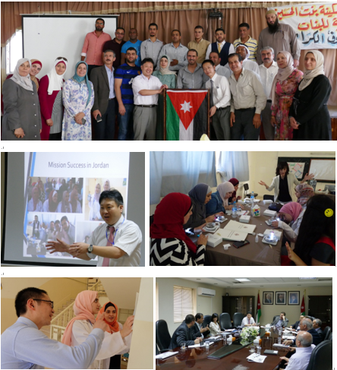
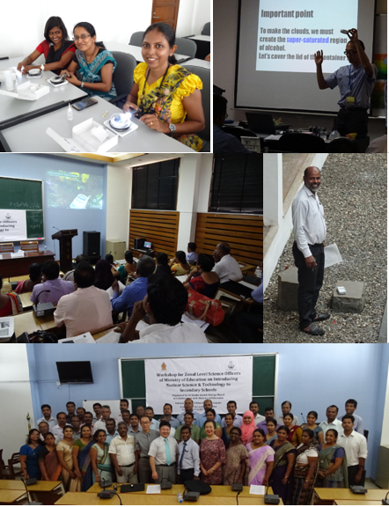
Acknowledgement
JVET photos in Sri Lanka
JVET photos Jordan
JVET express our sincere thanks to Dr. Takao Kawano (Japan Shield Technical Research Co., Ltd, (SANGA Holdings)) and Mr. Satoru Ozaki (Japan Science Foundation) for their strong supports to our activity and development.
Our activity was also supported by JSPS-KAKENHI, Grant Numbers ID:16H01813 (2016-2018), 19KK0057 (2019-2021), 23KK0040 (2023-2025) and 24K03145 (2024-2026), ERAN (Environmental Radioactivity Research Network Center), and Network-type Joint Usage/Research Center for Radiation Disaster Medical Science, as well as of course strongly by MOFA Japan and IAEA.
Logistical Information Relating to the International Conference on Nuclear Knowledge Management and Human Resources Development:
Challenges and Opportunities - 1-5 July 2024

