Slide 1
Practical School Application of Cloud Chambers for Various Education Subjects
International Conference on Nuclear Knowledge Management and Human Resources Development: Challenges and Opportunities
1 to 5 July 2024.
International Atomic Energy Agency
Vienna International Centre (VIC)
Indico ID #289
Takehiro Toda | RADO corporation Member of Japanese Volunteer’s Expert Team (JVET)
Takeshi Iimoto | Professor, The University of Tokyo/ Coordinator of JVET

Slide 2
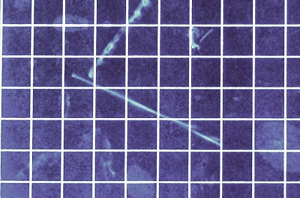
Why is Cloud Chamber for School Education ?
Cloud Chamber is a revolutionary device that allows us to see tracks of radiation. Cloud chambers have been mainly used in the field of radiation and nuclear science education. However, we believe that this device has great potential to be used for various educational subjects.
For example, in arithmetic, students can learn line graphs by using a cloud chamber to count the number of radiation changes over time.
In high school math, students can use the graph to calculate the half-life of a substance or study exponential functions.
Students can also learn to apply the theorem of the three squares by measuring the length of a radiation path using a cloud chamber.
In geography, the cloud chamber experiment is also useful for considering nuclear power generation as one of the solutions to the world's energy problems.
In geology, students can use cloud chambers to learn about rocks that emit radiation.
In the field of meteorology, cloud chambers can be used to learn about the process of cloud formation.
In this way, the cloud chamber can be used in a variety of subjects and grade levels.
Cloud Chamber Experiment
Sample Data of Counting Radiation
Study of the Theorem of Three Squares

Slide 3
Practical School Application of Cloud Chambers for Various Education Subjects
Cloud chambers have been mainly used in the field of radiation and nuclear science education. However, we believe that this device has great potential to be used for various educational subjects. The table below shows an example of its capabilities according to the official Japanese syllabus.
Generation Level and Subject | Explanation in Japanese Syllabus | Education Contents using Cloud Chamber | Education Contents
Grade 4 (9 years old) Arithmetic | A. Number and Calculation B. Graphic C. Change and Relationship (a) Through mathematical activities related to two quantities that change with each other, teach students to acquire the following skills. I. Acquire the following knowledge and skills. (1) To represent changes using tables, formulas, and line graphs, and to read the characteristics of changes. | Using a cloud chamber, alpha particle tracks can be observed. In the case of radon gas, the number of particles would be decreased minute by minute. On the other hand, in the case of monazite rocks, the number would not be timely changed. These time variations are recorded in tables and drawn in line graphs. The difference between them can be found and read by the tables and the graphs. | Introduction of the experiments including explanation on cloud chamber. (20min) Observation of radiation tracks in cloud chamber. (5min) Recording time variation of number of alpha particles from radon gas and monazite rocks (cpm). (10min) Drawing graphs of the time variation above and comparing changes over time. (10min)

Slide 4
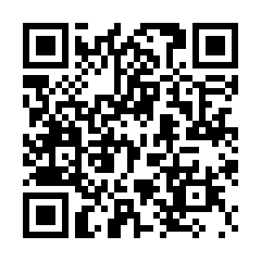
Educational Application of Cloud Chambers Targeting Each Generation Level
To assist educators in Member States, sample lesson plans for radiation education using different types of cloud chambers have been prepared.
These sample plans, document "Educational Application of Cloud Chambers Targeting Each Generation Level", show cloud chamber applications for different generations, from elementary school students to high school students.
These plans include not only science, but also various subjects such as geography, history, political economy, and mathematics. There are 28 such plans in total.
The document is uploaded and available for download on the following website: https://jvet.jp/fruits

Slide 5
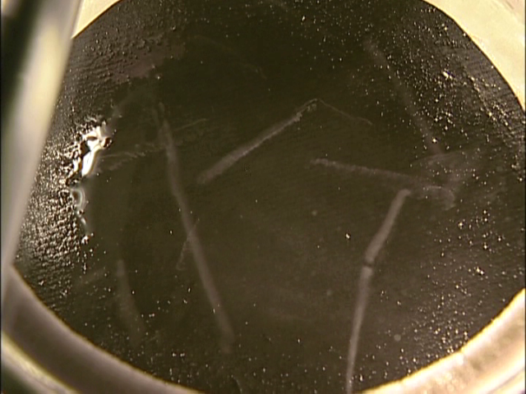
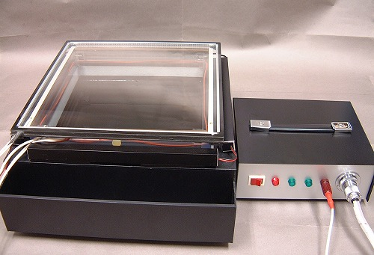
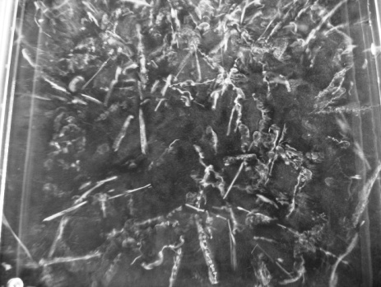
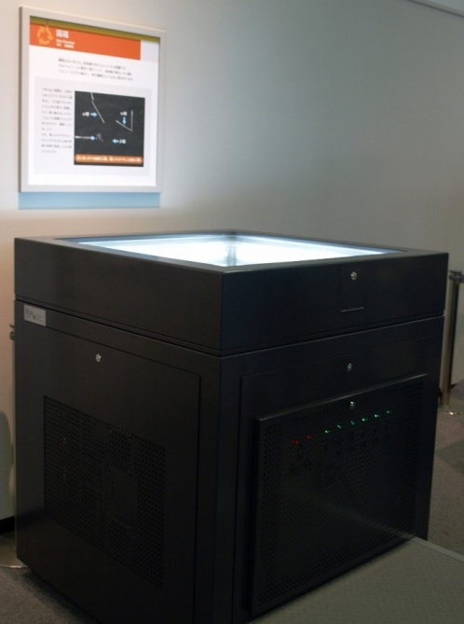
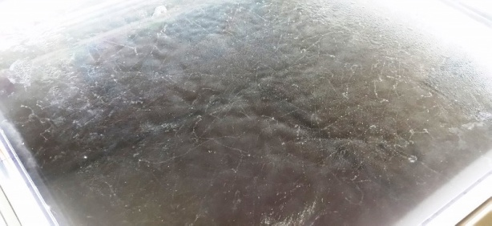
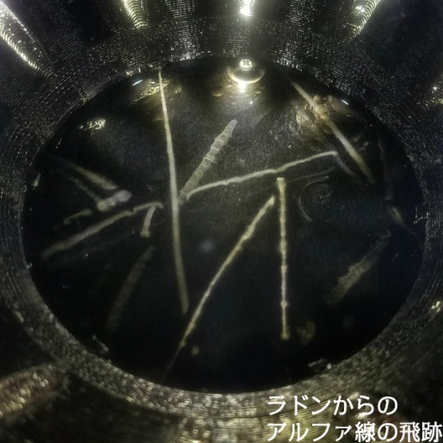
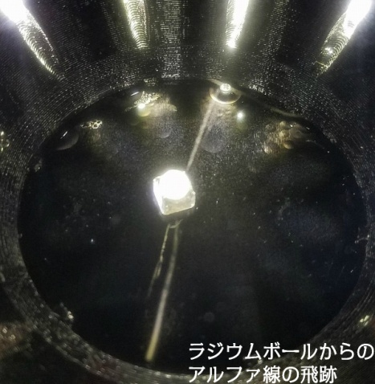
Types and characteristics of cloud chambers and their current main educational purposes
Types of cloud chambers | Pictures | Features and educational purposes
Dry Ice cooling （small & middle） |  | Assembling cloud chamber by hands in schools Understanding the principle of the cloud chamber Radiation sources; monazite and radon gas
Dry Ice cooling（large） |  | Mainly for high school and university students Experiment of the permeability of radiation Experiments on the Compton scattering and half life Using liquid nitrogen, easy to got at schools. Mainly for observation of the tracks of natural radiations
Liquid nitrogen cooling
Compressor cooling |  | Displayed in science museums Observing many tracks through a large observation window Easy to understand the existence of the natural radiation Coolant such as dry ice, unnecessary Easy to observe long tracks of cosmic rays
Peltier element cooling |  | Coolant such as dry ice, unnecessary. Short preparation time to see tracks of radiation Radiation sources; monazite and radon gas Mainly for observation of the tracks of natural radiations

